Slide 1


FED TAPERING
DERIVATIVE MARKET

Slide 2

Simplifying how derivative products operate in the stock market – By Prof. Simply Simple TM

Slide 3

DERIVATIVE MARKET
Imagine there are several farmers in a market. Some have a view that the price of Wheat is going to fall in the near future (bearish participants)

Slide 4
DERIVATIVE MARKET
Also some bakers have a view that the price of wheat is going to rise in the near future (bullish participants)

Slide 5
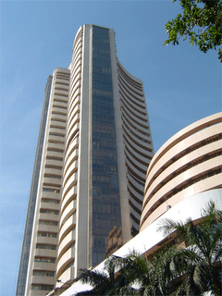
DERIVATIVE MARKET
The market place has free flow of information. It provides a platform to both bullish & bearish participants to execute their trades without even knowing each other or hunting for counterparties.

Slide 6
DERIVATIVE MARKET
So the expected future price (price of wheat) is known to every farmer and bread manufacturer.
Any farmer trying to extract a higher price will not be able to do so because for the bread manufacturer there are several other farmers to buy from and vice versa.

Slide 7
DERIVATIVE MARKET
Since the price is universally known and there are several farmers and bread manufacturers, there is no need to get into individual contracts.
There is no need to know who the options/futures buyer is and who the options/futures seller is for it does not make any difference for either party.

Slide 8
DERIVATIVE MARKET
The markets also make it possible for either party to deal with several counter parties at the same time.
The market thus makes it possible to keep identities of parties to remain confidential with respect to the respective counter parties.
If one were to replace the farmer and bread manufacturer by normal people who have opposite views about the future prices of stocks, what we have is a typical Derivatives Market.

Slide 9
DERIVATIVE MARKET
So in a nutshell…
The market provides a platform for several parties and counter parties to come together to trade over stocks about which information is free flowing)
This leads to a single future price for all participants, thereby rendering irrelevant the need to know who the buyer for the seller and vice versa
Despite all of the above, the market system independently has all the necessary information about the market participants.

Slide 10
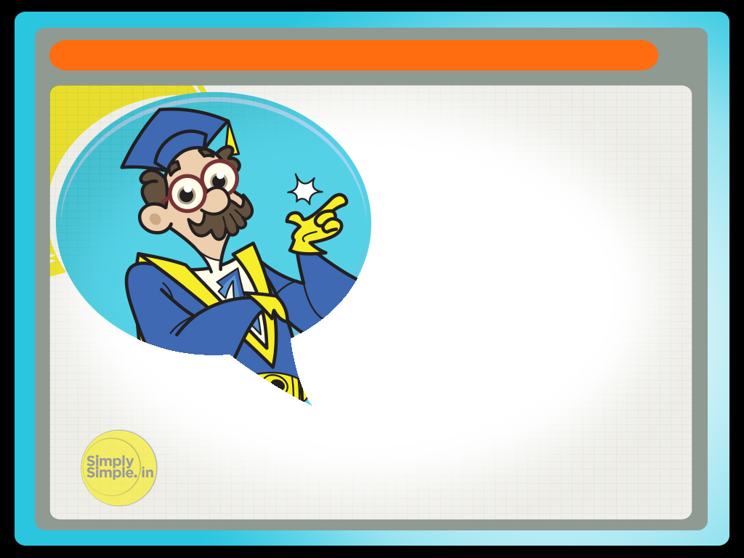
DERIVATIVE MARKET
I hope you understood the derivative market dynamics and why there is no need to know the names of counter parties.

Slide 11

Please give your feedback at
professor@tataamc.com

Slide 12

DISCLAIMER
The views expressed in this lesson are for information purposes only and do not construe to be any investment, legal or taxation advice. The lesson is a conceptual representation and may not include several nuances that are associated and vital. The purpose of this lesson is to clarify the basics of the concept so that readers at large can relate and thereby take more interest in the product / concept. In a nutshell, Professor Simply Simple lessons should be seen from the perspective of it being a primer on financial concepts. The contents are topical in nature and held true at the time of creation of the lesson. This is not indicative of future market trends, nor is Tata Asset Management Ltd. attempting to predict the same. Reprinting any part of this material will be at your own risk. Tata Asset Management Ltd. will not be liable for the consequences of such action.
Mutual Fund investments are subject to market risks, read all scheme related documents carefully.

